Slide 1

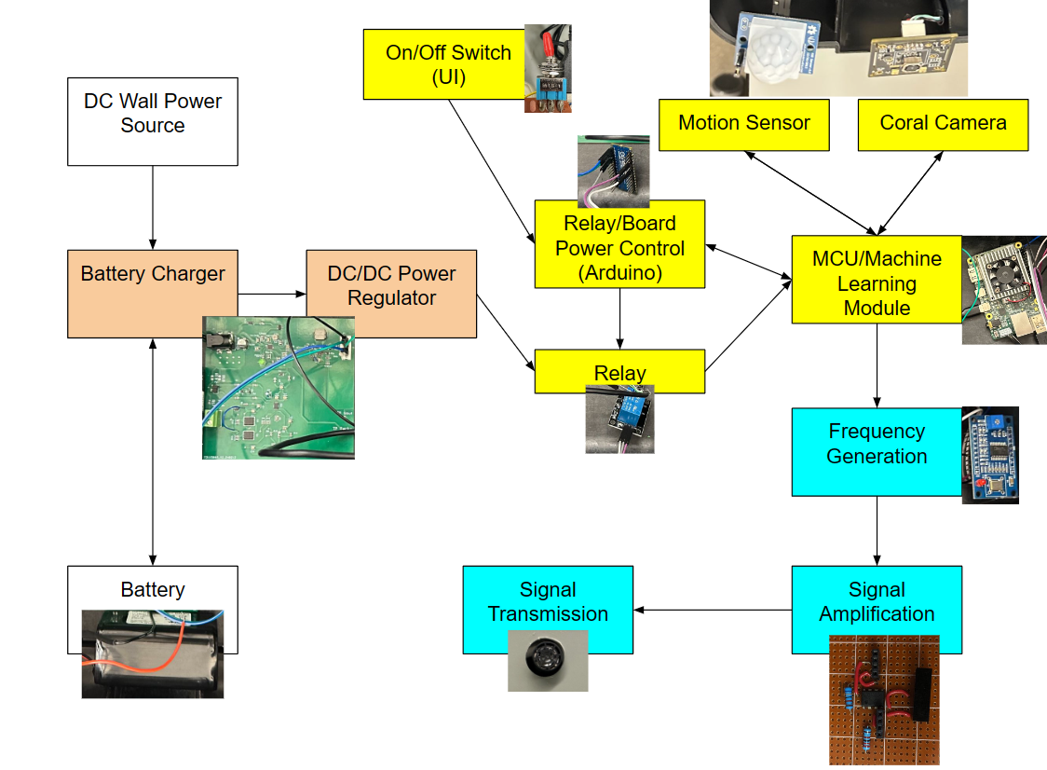
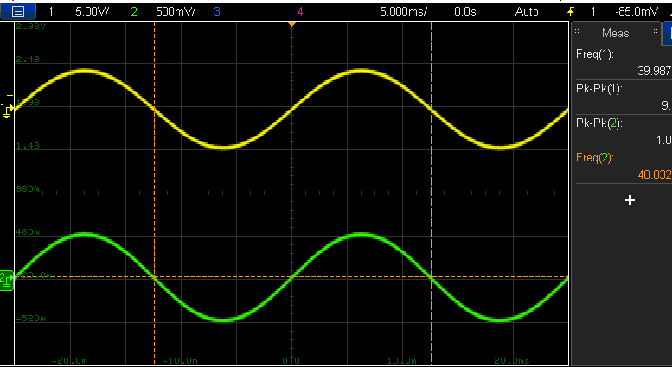
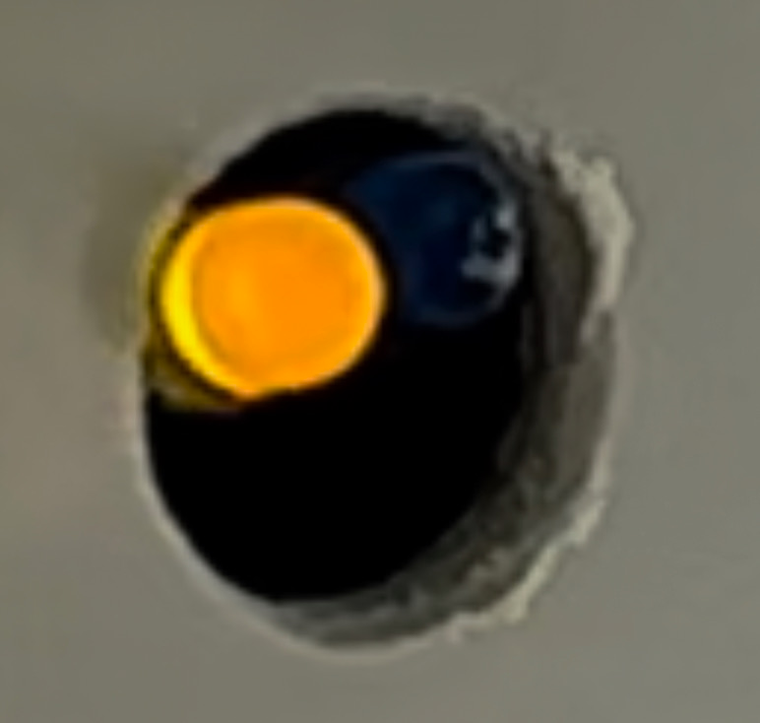
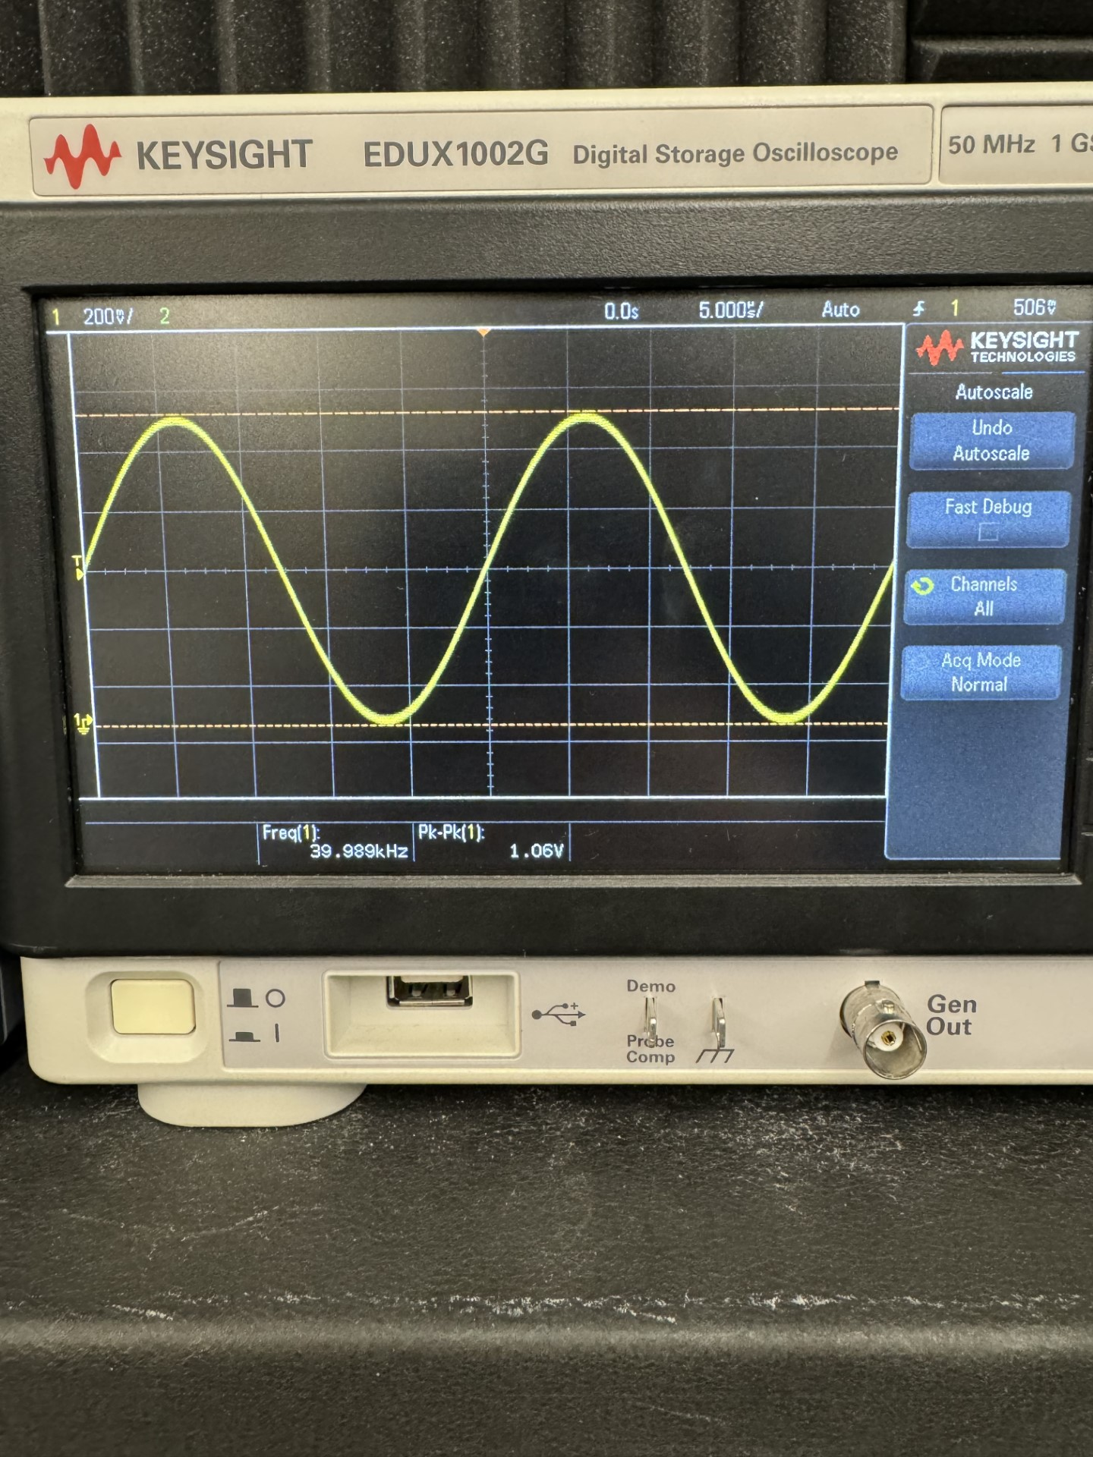
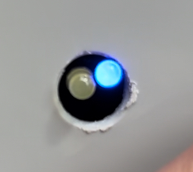
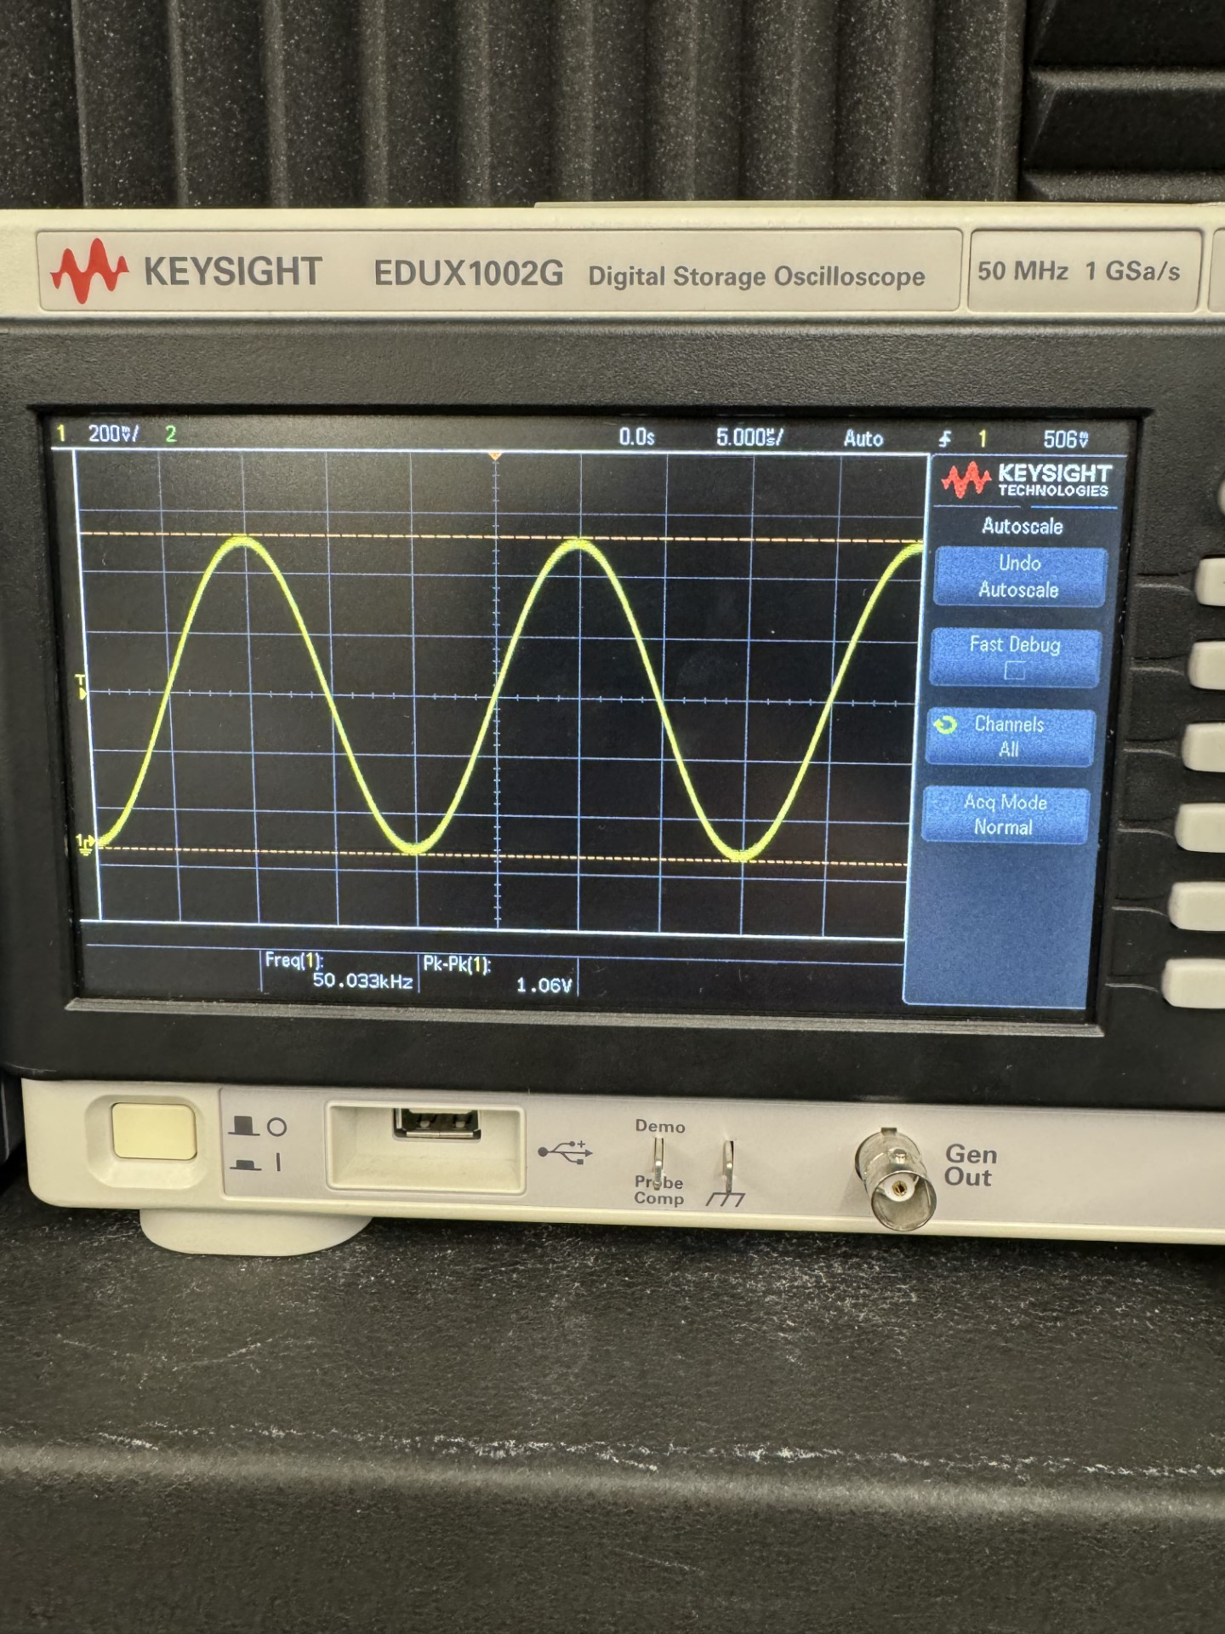
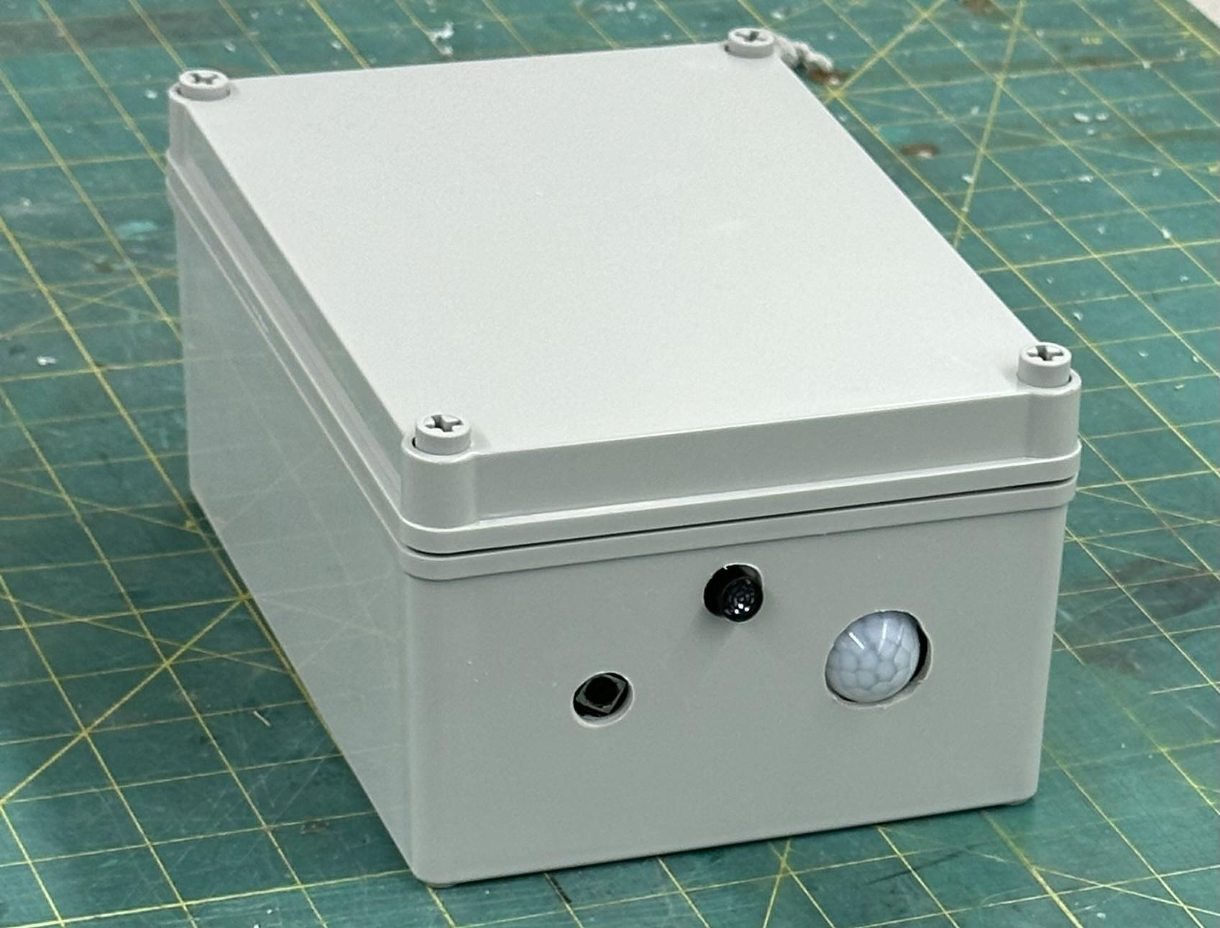
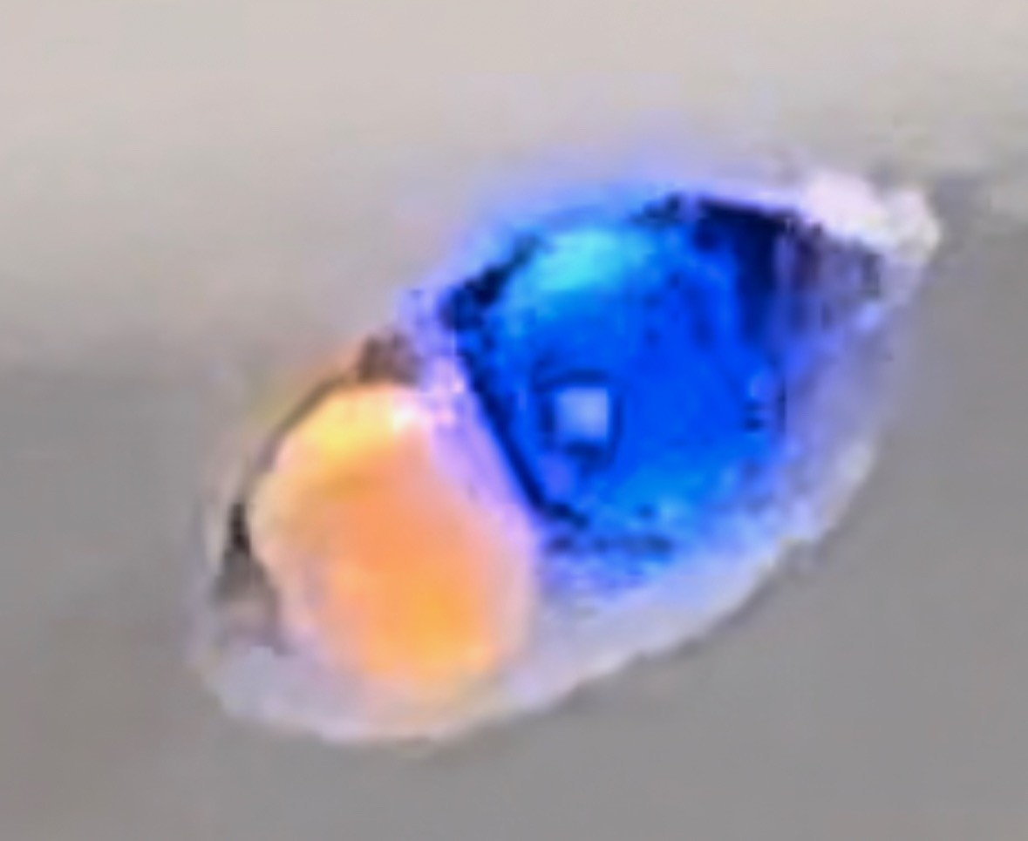
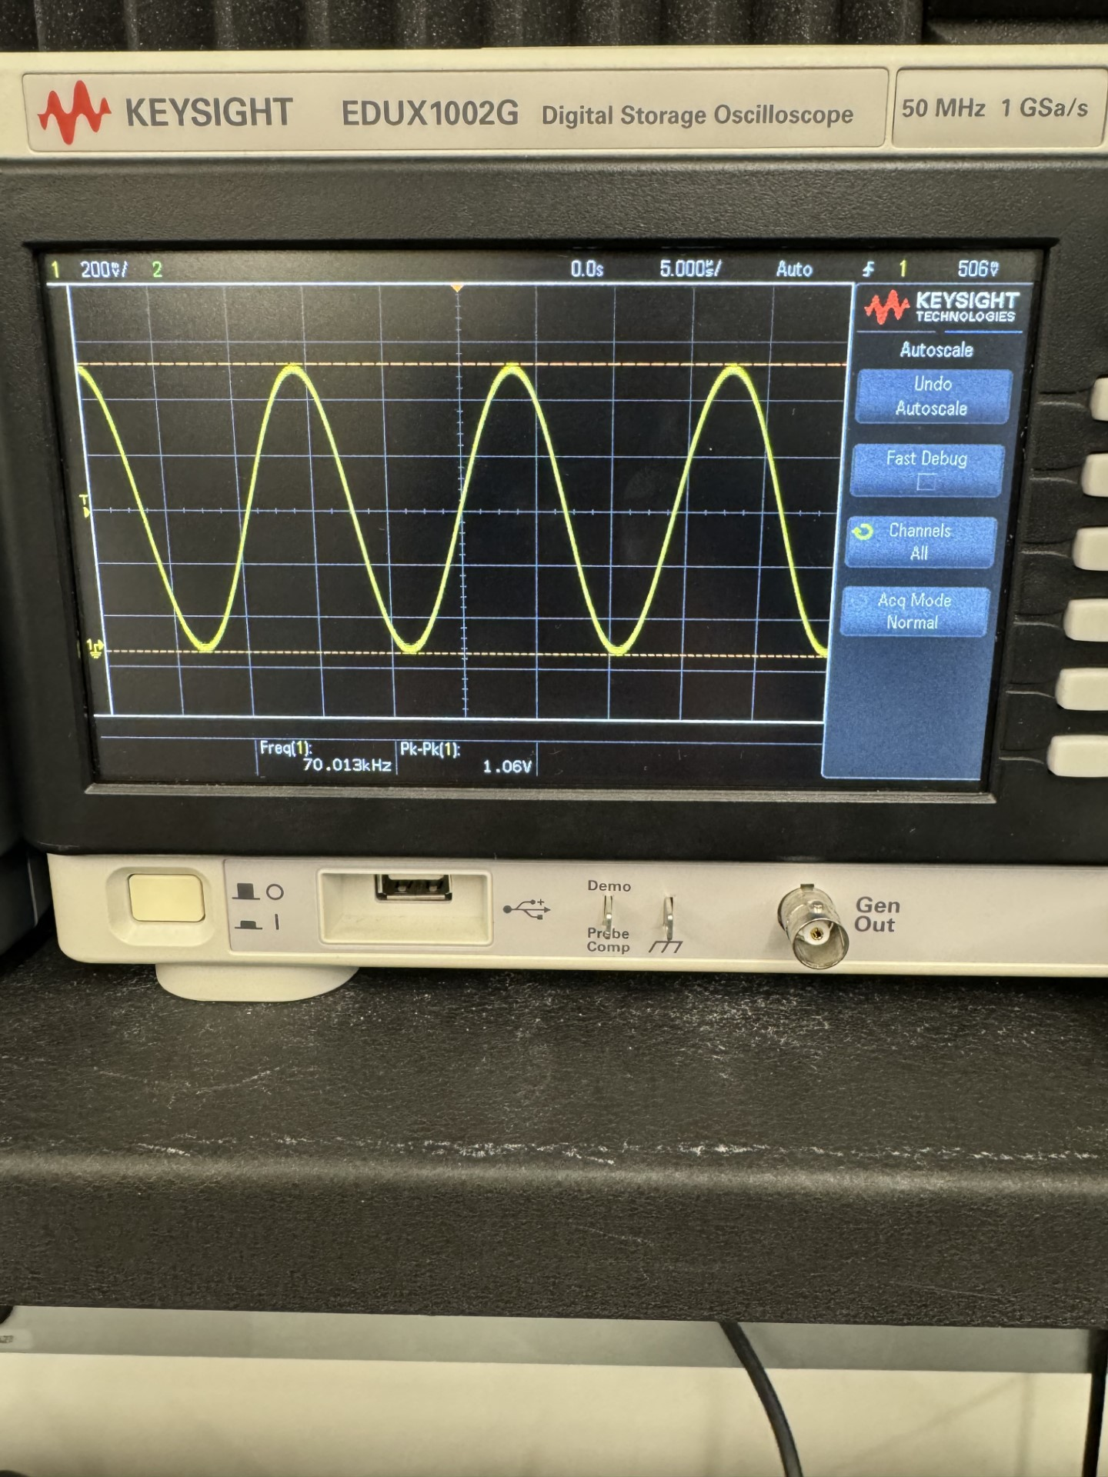
EPS Booth: 354
Smart Pest Repeller
Andrew Albritton, Michael McNeil, Melquisedec Ordonez
Faculty Mentor: Peng Hao Huang
Problem Definition
Ultrasonic pest repelling solutions on the market are not very effective but increasing concerns about the environmental drawbacks of pesticides make this solution undesirable. Our team was tasked with creating an ultrasonic pest repelling solution that is more effective than current solutions on the market.
Engineering Analysis
The Smart Pest Repeller is meant to be an easily installed, small form factor device, to deter pests from a small garden environment. To achieve this goal we met the following constraints:
Accuracy of detection after post processing must be above 90%.
The speed of detection must be sufficiently high in order to repel pests in a timely manner.
Distance of detection must be large enough to cover a small garden.
Generated frequency must be amplified for sufficient emitter volume.
Functional Block Diagram
Table 3. Power Specifications
Specification | Min | Nominal | Max
Output DC Voltage | 4.5 | 5.0 | 5.2
Output DC Current | 1.0 | 2.0 | 2.2
Charger DC Voltage Output | 4.9 | 7.0 | 7.2
Charger DC Current Output | 1.8 | 2.0 | 2.2
The power system specifications are listed above. The system was able to be very efficient and draws less than 10W of power during operation.
Methodology
Our project consists of 3 main subsystems, power / battery management, detection / identification, and signal generation / emission.
Power & Battery Management
Implemented a power source using 7.2V 6.5Ah battery, can be charged via 12V DC input.
Delivers power to detection and signal subsystems
Detection & Identification
Implemented a YOLOv5 CNN for identification of species of interest (fly, lizard, rat). Accelerated by TPU for real time video detection at 20 FPS.
Used motion sensor to trigger detection mechanism
Signal Generation & Emission
One of three different frequency signals generated based on classification from detector.
Signal is then amplified before reaching ultrasonic emitter.
Figure 3. Full System block diagram
Outcomes
Our project was able to output three different noise responses based on categories created for different pest categories. Due to lack of suitable testing equipment we were unable to test for noise intensity. We were also unable to implement a display for the user due to limited GPIO space on the main microcontroller but LED indicators were added to indicate to the user which noise response is active.
Impact
The Smart Pest Repeller is designed for consumers to have access to easy, effective, and safe pest control. As a group it allowed us to experiment with:
Variable Noise Responses: Creating signals that repel pest without causing damage to user and immediate environment.
Image Classification Models and Tuning: Using a model that is capable of meeting the accuracy requirements across different categories.
Power Delivery Management: Enabling full use of system whether employed indoors or outdoors.
neque dignissim, and inaliquet nisl et umis.
Specification
Processing Speed | 20 FPS | 50 Images | 2.5-3.5 Seconds
Detection Accuracy | Flies: 20-20 (100%) | Lizards: 16-20 (80%) | Rats: 19-20 (95%)
Minimum-Maximum Distance of Classification | Flies: min 3in max 2ft | Lizards: min 4in max 3.5ft | Rats: min 4in max 4ft
Table 1. Detection Specifications
Input: 40KHz at ~1Vpk-pk
Output: 40KHz at ~9Vpk-pk
Figure 4. User Alert for flies / output waveform 40KHz
Figure 2: Amplifier gain from input sequence. (Same across three required frequencies).
References
“Osha Technical Manual (OTM) - Section III: Chapter 5.” Occupational Safety and Health Administration, 6 July 2022, www.osha.gov/otm/section-3-health-hazards/chapter-5.
“Ultrasonic Frequencies for Repelling Insects and Pests” - D. Mohankumar, 01 Dec. 2009 - Ultrasonic Frequencies For Repelling Insects & PestsBack ButtonSearch IconFilter Icon (electroschematics.com)
Specification | Expected | Tested
Range | 2 feet | 1 feet
Gain | 7V/V(~17dB) | 9V/V(~19dB)
SPL | 85dB at 30cm | -
Figure 5. User Alert for Lizards / output waveform 50KHz
Acknowledgements
Peng Hao Huang
Figure 1. Full System Enclosure
Table 2. Emitter Specifications
Figure 6. User Alert for Rodents / output waveform 70KHz

